Slide 1
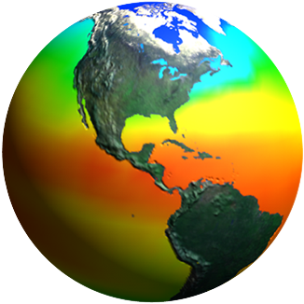
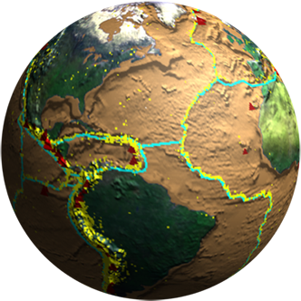
Biodiversity and Ecological Forecasting Team Meeting
Westin Seattle, Seattle, WA
NASA Programmatic Issues
(with thanks to Mike Freilich for most slides)
Woody Turner
Earth Science Division, NASA Headquarters
April 27, 2012

Slide 2
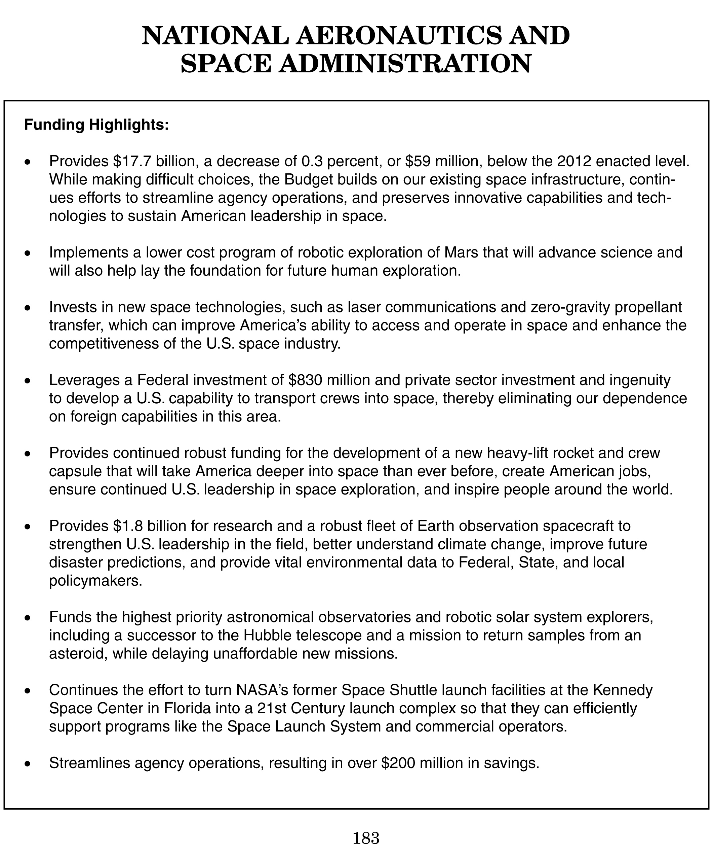
NASA “Highlights” Page from Budget Document

Slide 3
Earth Science Budget - History
FY10 request
Prev Admin

Slide 4
Earth Science Budget – FY13 Request
FY10 request
Prev Admin

Slide 5
Earth Science Budget Overview
The FY13 budget for Earth Science is consistent with the FY12 request – STABILITY!
Congressional appropriation for FY12 was also consistent with the President’s budget request
FY13 overall ESD funding level is ~$25M above FY12 appropriated level
Overall NASA agency FY13 level represents 0.3% decrease from FY12; SMD overall budget decreased by ~3.3% from FY12
The March 2011 Glory launch failure has resulted in delays for OCO-2 and SMAP launches, and significantly higher budgeted cost levels for mid-range launch vehicles
Solicitation for multiple launch services for OCO-2, SMAP (and JPSS-1) has been released – with higher evaluation emphasis on vehicle reliability
SMAP launch date: 23 Oct 2014
OCO-2 launch date: NET July 2014 (SMAP launch date has priority)
FY13-vs-FY12 decreases in R&A (1.5%), Applied Science (5%), and Technology (3.3%) lines; however, all non-flight lines increase throughout 2013-2017
All 3 strands of Venture Class are fully funded throughout, with all AOs released

Slide 6
Earth Science Program/Budget Strategy
Maintain a balanced program that:
advances Earth System Science
delivers societal benefit through Applications Development
provides essential global spaceborne measurements supporting science and operations
develops and demonstrates technologies for next-generation measurements, and
complements and is coordinated with activities of other agencies and international partners
Support Research, Applied Sciences, Technology Development, and E/PO programs
Continue to fund operations and routine data products for all on-orbit NASA research missions
Develop and launch remaining foundational missions: LDCM (1/2013), GPM (2/2014), OCO-2 (2014)
Continue formulation and development of top-priority Decadal Survey and Continuity missions: SMAP (11/2014), ICESat-2 (2016), SAGE-III/ISS (2014), GRACE-FO (2017), PACE (2020), SWOT (2020).
Continue execution of the full Venture Class program
Continue working with NOAA and OSTP to address approaches for providing sustained, long-term spaceborne measurements.
Provide significant support to National Climate Assessment, USGCRP, and international (CEOS) coordination activities

Slide 7
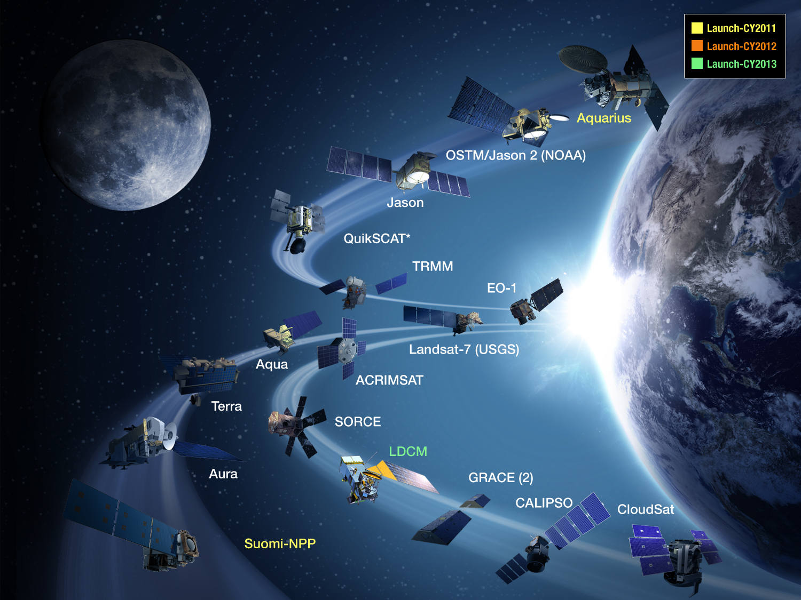

Slide 8
Costing Is Key!
NASA counts grant funds as “costed” when we receive an invoice from you spending the funds—not just from the point when funds are available to you but actually spent by you
It is imperative to cost any remaining FY10 and FY11 funds in your projects
“Uncosted” funds will be grounds for our stakeholders to reduce our FY13 budget!
Please cost your funds!!

Slide 9
Applied Sciences Program Associates
Provide day-to-day management and tracking of Applications project portfolio and identify issues requiring Program Manager attention
- Aligned with an Applications area
Based at Centers and JPL
Key Responsibilities:
Manage Applied Sciences applications awards for specific Applications and track project schedule/milestones, cost, and performance
Interact with Project Teams and Managers, Earth science community, and Partners to ensure successful, on-schedule completion of projects and tasks awarded by Applied Sciences
Contribute to planning, implementation, and review of Applied Sciences and specific Applications portfolio
Identify projects to highlight and results to nurture and harvest
Participate in annual reviews, demonstrations, and site visits
Make recommendations on key gaps, strategy, implementation, partners
Ecological Forecasting Associates are Gary Geller, Maury Estes, Jay Skiles

Slide 10
Applications Readiness Levels (ARLs): A New Tool to Measure Progress by Applied Sciences Projects

Slide 11
ROSES 2012
A.26: Rapid Response and Novel Research in
Earth Science
Research on Earth system events or opportunities to collaborate that occur unpredictably as rare and valuable targets of opportunity and that require rapid provision of resources to enable immediate research activity to take advantage of that target of opportunity
First-time investigations applying novel and innovative ideas to advance Earth remote sensing in a previously undeveloped area of remote sensing theory, technology utilization, or scientific application
A.36: Ecological Forecasting Applications Feasibility
Projects
Biodiversity in ROSES 2013: TBD

